Slide 1

ENTEVYUV 10.0 Estimating Video Likes using Comment Data
Sham Hiruthik
GUVI DS Student (DW39)

Slide 2
Agenda
Problem Statement and Aim
Tools Used
Project Process
Approaches and EDA
Model Evaluation & Comparison
Conclusion

Slide 3


Problem Statement
Content creators, marketers, and platform administrators lack a reliable tool to estimate the potential popularity of their videos based on comment information.
Project Aim
to develop a machine learning model that predicts video popularity using comments, empowering decision-making, content optimization, and marketing strategies on video-sharing platforms.

Slide 4
Project Process
Data Preparation
Data Merging
Data Cleaning
EDA
Preprocessing
Importing necessary libraries
Loading Data
View Data
Getting to know the data
Since there are two datasets, merging is necessary
Remove unnecessary features
Rename columns
handle null values
Handle regular expressions
Exploring the data and getting insights from them
Remove unnecessary space, symbols, numbers etc.
Remove stopwords
Lemmatize the text

Slide 5
Project Process
Vectorization and Feature Extraction
Train Test Split
Scaling
Model Evaluation & Comparison
Conclusion
Turn the text into numerical form
extract a range of features
Split the data into 80% train and 20% test dataset
As the data shows a range of variations Scaling is a option to normalize the data
train the model on different algorithms and evaluate the model using MSE, MAE and R2 score
Compare the models
Finalize the best performing model.

Slide 6


APPROACHES
VECTORIZATION AND FEATURE EXTRACTION
applied and compared two different vectorization techniques :
Count vectorizer
TF-IDF Vectorizer
selected count vectorizer, as this showed better performance after comparison from (96% to 99%)
for feature extraction used max_features method.
SCALING
the features showed a range of variations. which needed scaling. Compared two different techniques:
StandardScaler
MinMaxScaler
selected standard Scaler for scaling.

Slide 7
Title with highest number of comments
Title with lowest number of comments
El Chombo | Dame Tu Cosita feat. Cutty Ranks | Official Video | Ultra Music
BEST Auditions Of Songs From Movies Amazing Auditions
Title with most number of likes
Title with least number of likes
El Chombo | Dame Tu Cosita feat. Cutty Ranks | Official Video | Ultra Music
How To Build A Business That Works Brian Tracy | GENIUS
Title with most number of views
Title with least number of views
Chombo | Dame Tu Cosita feat. Cutty Ranks | Official Video | Ultra Music.
Mathematics and Chemistry MathChemistry.com | Masters Degree in Math

Slide 8
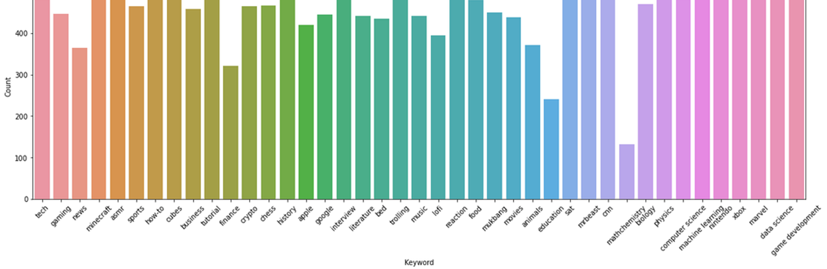
Visualizations
Keywords

Slide 9
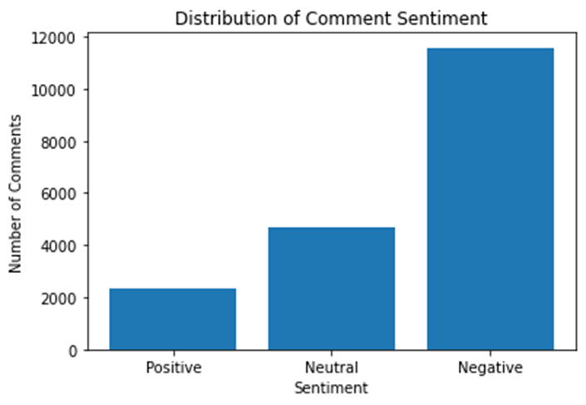
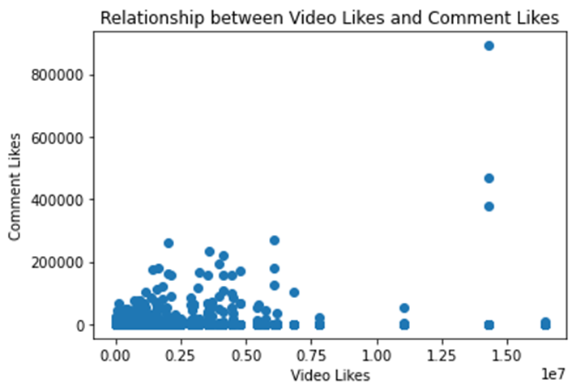
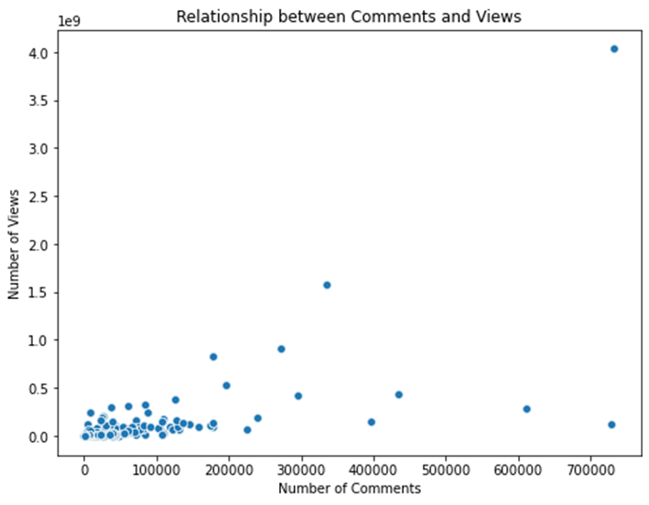
Visualizations

Slide 10
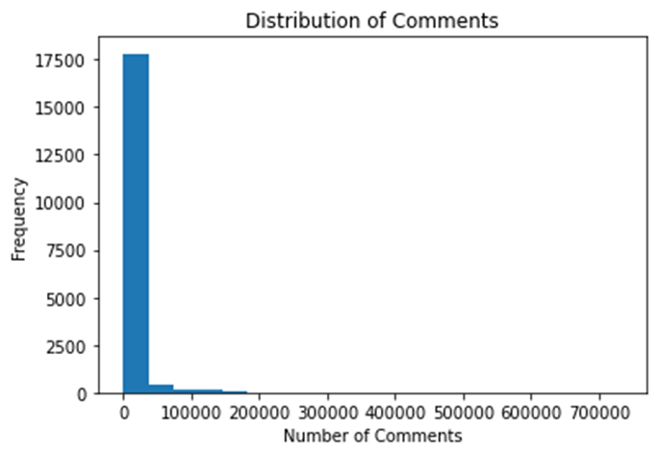
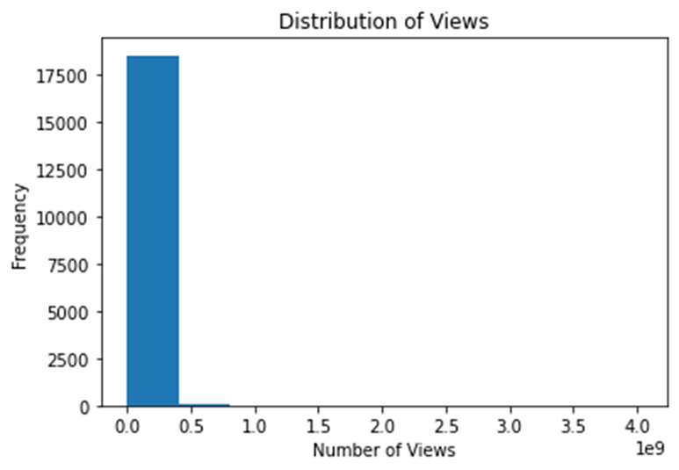
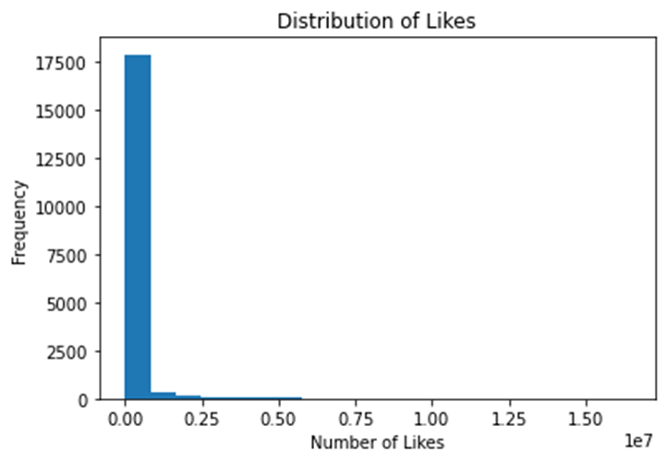
Visualizations

Slide 11
MODEL EVALUATION & COMPARISON
DECISION TREE | RANDOM FOREST | GRADIENT BOOSTING
MAE: 80025413.010899 | MAE: 1125519310.14774 | MAE: 7387141277.98380
MSE : 2547.184589899 | MSE : 7164.4535500 | MSE : 33273.009188345066
R2 score : 0.98998 | R2 score : 0.9982 | R2 score : 0.988

Slide 12




Thank you
Any questions?
You can find me at:
@shamhiruthik
shamhiruthik18@gmail.com

